Slide 1
Requirement Engineering

Slide 2
The whole picture
Requirements engineering
Requirement
document
VV requirements
Requirement
document
Design .
VV design
Design
document
Design
document
Implement unit
VV unit
Unit
Unit
Implement unit
Unit
VV unit
Unit
Integrate units
System
VV system
System
Project management
Configuration management
Quality management

Slide 3
Requirements engineering
The process of establishing the services that the customer requires from a system and the constraints under which it operates and is developed.
The requirements themselves are the descriptions of the system services and constraints that are generated during the requirements engineering process.

Slide 4
What is a requirement?
  It may range from a high-level abstract statement of a service or of a system constraint to a detailed mathematical functional specification.
  This is inevitable as requirements may serve a dual function
    May be the basis for a bid for a contract - therefore must be open to interpretation;
    May be the basis for the contract itself - therefore must be defined in detail;
  Both these statements may be called requirements.

Slide 5
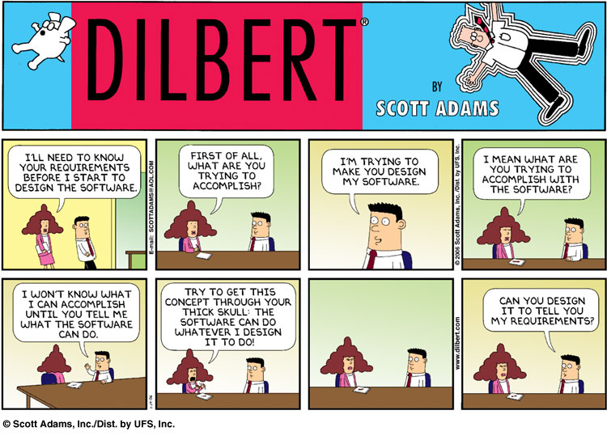
Activities in req. engineering

Slide 6
Activities in req. engineering
Elicitation
Analysis
Formalization
V&V

Slide 7
Stakeholders in req. engineering
Stakeholder
    Role or person with an interest (stake) in the system to be built
  User
    Uses the system
    Can include different user profiles
  Customer
    Pays for the system
  Administrator
  Developer

Slide 8
Stakeholders - example
Account management system in a bank
User
  Clerk at counter (profile 1)
  Bank customer at home (profile 2)
Customer
  CEO of bank and/or CTO of bank
IT administrator
  Manages all applications in the bank
DB administrator
  Manages DBMSs on which applications are based
Security manager
  Responsible for security issues

Slide 9
Req. eng process
elicitation
stakeholders
Informal
description
formalization
analyst
Requirement
document
verification and
validation

Slide 10
Types of requirements
User, system/developer
Domain
Functional, non functional

Slide 11
Types of requirement
User requirements
    Statements in natural language plus diagrams of the services the system provides and its operational constraints. Written for customers.
System requirements (developer requirements)
    A structured document setting out detailed descriptions of the system’s functions, services and operational constraints. Defines what should be implemented so may be part of a contract between client and contractor.

Slide 12
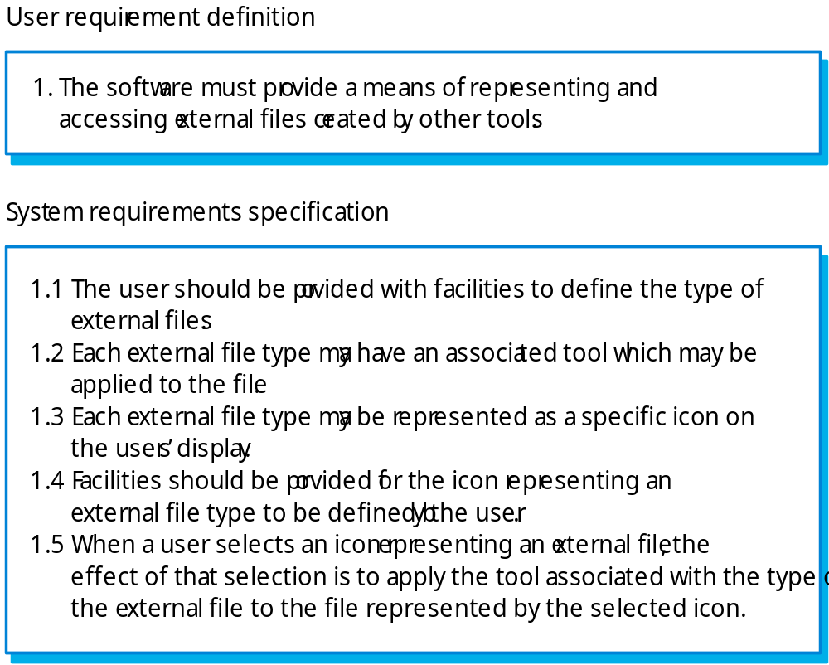
Definitions and specifications

Slide 13
Types of requirements - 2
Functional requirements
    Statements of services the system should provide, how the system should react to particular inputs and how the system should behave in particular situations.
Non-functional requirements
    constraints on the services or functions offered by the system such as timing constraints, constraints on the development process, standards, etc.
Domain requirements
    Requirements that come from the application domain of the system and that reflect characteristics of that domain.

Slide 14
Domain
Collection of related functionality
or
collection of applications with similar functionality)
  Ex. banking, that includes subdomains account management, portfolio managemenmt, etc
  Ex. telecommunication, that includes subdomains switching, protocols, telephony, switching

Slide 15
Application
Or system
Software system supporting a specific set of functions. Belongs to one or more domains

Slide 16
Ex.: The LIBSYS system
A library system that provides a single interface to a number of databases of articles in different libraries.
Users can search for, download and print these articles for personal study.

Slide 17
LIBSYS UDAY-SANDRA
User reqs
  Download, print and search docs in dbs
  Don't modify docs
Dev reqs
  Unique interface for db
  Manage user accounts to login
  Provide documents to preview, templates
  Books id

Slide 18
LIBSYS ALBERTO-SIMONE
User reqs
  Interace with all o.s., and possibly not installed in pcs (i.e. Web int.),
  Log in for each user (roles)
  Maximum printable pages with notifications of “credit”
Dev. Reqs
  web interface works with all browsers
  Login system
  Search by authors, arguments,title
  Policy for printing
  Update database w.r.t role
  Maximum contemporary accesses to the systems : 20

Slide 19
LIBSYS CAROLINE-ANTONINO
USER REQS
  Open src systems
  Feed back system
PR REQS
  Search by author, genre and year of publications
  Format selection for download of the file
  Conversion tools pdf-> word for file modifications
  Db files : pdf
  Content -based search
  Realt ime translations in 3 langs of the interface (english, spanish and italian)

Slide 20
Examples functional req.
  The user shall be able to search either all of the initial set of databases or select a subset from it.
  The system shall provide appropriate viewers for the user to read documents in the document store.
  Every order shall be allocated a unique identifier (ORDER_ID) which the user shall be able to copy to the account’s permanent storage area.

Slide 21
Requirements imprecision
  Problems arise when requirements are not precisely stated.
  Ambiguous requirements may be interpreted in different ways by developers and users.
  Consider the term ‘appropriate viewers’
    User intention - special purpose viewer for each different document type;
    Developer interpretation - Provide a text viewer that shows the contents of the document.

Slide 22
Completeness and consistency
In principle, requirements should be both complete and consistent.
  Complete
    They should include descriptions of all facilities required.
  Consistent
    There should be no conflicts or contradictions in the descriptions of the system facilities.
  In practice, it is impossible to produce a complete and consistent requirements document.

Slide 23
Defects in requirements
Omission/ incompleteness
Incorrect Fact
Inconsistency/contradiction
Ambiguity
Extraneous Information
  Overspecification (design)
Un-reality
Un-verifiability
Un-traceability
Notes:
Vedi slide su vv, inspection on req, basili taxonomy

Slide 24
Non-functional requirements
  These define system properties and constraints e.g. reliability, response time and storage requirements. Constraints are I/O device capability, system representations, etc.
  Process requirements may also be specified mandating a particular CASE system, programming language or development method.
  Non-functional requirements may be more critical than functional requirements. If these are not met, the system is useless.

Slide 25
Non-functional reqs
Product requirements
    Requirements which specify that the delivered product must behave in a particular way e.g. execution speed, reliability, etc.
Organisational requirements
    Requirements which are a consequence of organisational policies and procedures e.g. process standards used, implementation requirements, etc.
External requirements
    Requirements which arise from factors which are external to the system and its development process e.g. interoperability requirements, legislative requirements, etc.

Slide 26
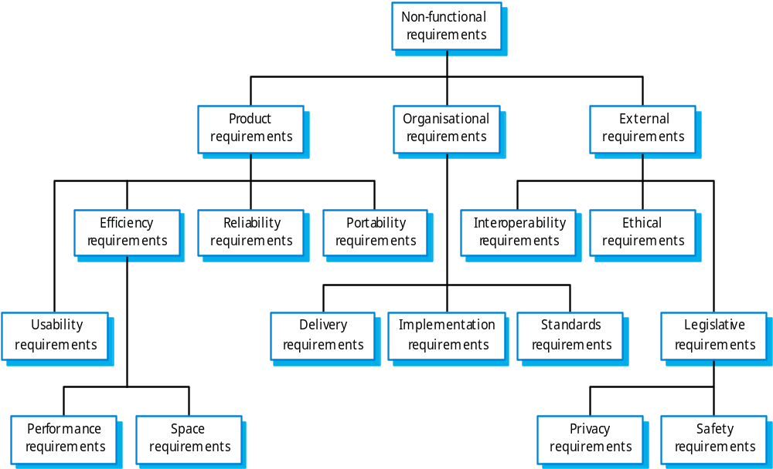
Non-functional requirements

Slide 27
ISO 9126
  Defines 6 properties of software systems – 5 non functional
    Functionality
    Reliability
    Usability
    Efficiency
    Maintainability
    Portability

Slide 28
Non-functional req.: examples
Product requirement
    8.1 The user interface for LIBSYS shall be implemented as simple HTML without frames or Java applets.
Organisational requirement
    9.3.2 The system development process and deliverable documents shall conform to the process and deliverables defined in XYZCo-SP-STAN-95.
External requirement
    7.6.5 The system shall not disclose any personal information about customers apart from their name and reference number to the operators of the system.

Slide 29
Goals and requirements
Non-functional requirements may be very difficult to state precisely and imprecise requirements may be difficult to verify.
Goal
    A general intention of the user such as ease of use.
Verifiable non-functional requirement
    A statement using some measure that can be objectively tested.
Goals are helpful to developers as they convey the intentions of the system users.

Slide 30
Examples
A system goal
  The system should be easy to use by experienced controllers and should be organised in such a way that user errors are minimised.
A verifiable non-functional requirement
  Experienced controllers shall be able to use all the system functions after a total of two hours training. After this training, the average number of errors made by experienced users shall not exceed two per day.

Slide 31
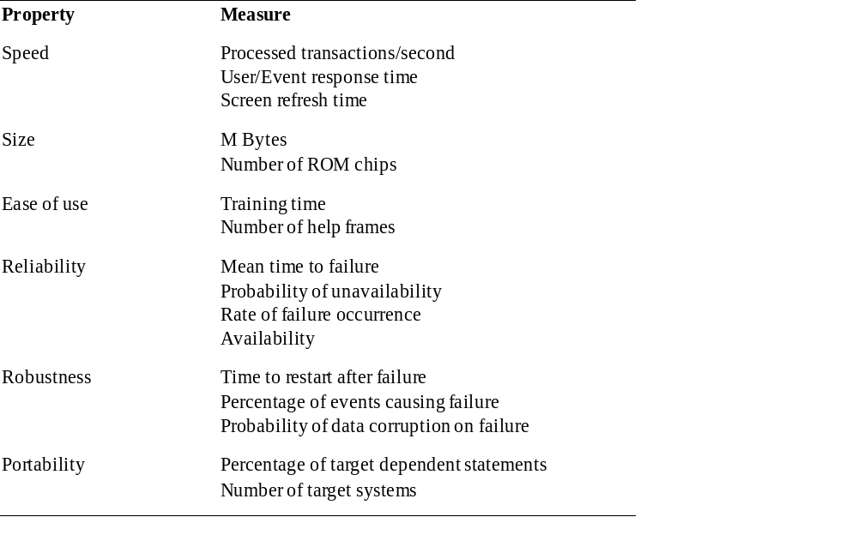
Measures for NF reqs

Slide 32
Requirements interaction
Conflicts between different non-functional requirements are common in complex systems.
Spacecraft system
    To minimise weight, the number of separate chips in the system should be minimised.
    To minimise power consumption, lower power chips should be used.
    However, using low power chips may mean that more chips have to be used. Which is the most critical requirement?

Slide 33
Domain requirements
  Derived from the application domain and describe system characteristics and features that reflect the domain.
  Domain requirements can be new functional requirements, constraints on existing requirements or define specific computations.
  If domain requirements are not satisfied, the system may be unworkable.

Slide 34
LIBSYS domain requirements
  There shall be a standard user interface to all databases which shall be based on the Z39.50 standard.
  Because of copyright restrictions, some documents must be deleted immediately on arrival. Depending on the user’s requirements, these documents will either be printed locally on the system server for manually forwarding to the user or routed to a network printer.

Slide 35
Train protection system
The deceleration of the train shall be computed as:
  D_{train} = D_{control} + D_{gradient}
where D_{gradient} is 9.81ms² * compensated gradient/alpha and where the values of 9.81ms² /alpha are known for different types of train.

Slide 36
Domain req. problems
Understandability
  Requirements are expressed in the language of the application domain;
  This is often not understood by software engineers developing the system.
Implicitness
  Domain specialists understand the area so well that they do not think of making the domain requirements explicit.

Slide 37
User requirements
Should describe functional and non-functional requirements in such a way that they are understandable by system users who don’t have detailed technical knowledge.
User requirements are defined using natural language, tables and diagrams as these can be understood by all users.

Slide 38
Problems, natural language
Lack of clarity
  Precision is difficult without making the document difficult to read.
Requirements confusion
  Functional and non-functional requirements tend to be mixed-up.
Requirements amalgamation
  Several different requirements may be expressed together.

Slide 39
Problems, natural language
Ambiguity
    The readers and writers of the requirement must interpret the same words in the same way. NL is naturally ambiguous so this is very difficult.
Over-flexibility
    The same thing may be said in a number of different ways in the specification.
Lack of modularisation
    NL structures are inadequate to structure system requirements.

Slide 40
LIBSYS requirement
4..5 LIBSYS shall provide a financial accounting system that maintains records of all payments made by users of the system. System managers may configure this system so that regular users may receive discounted rates.

Slide 41
Editor grid requirement
2.6 Grid facilities To assist in the positioning of entities on a diagram,
the user may turn on a grid in either centimetres or inches, via an
option on the control panel. Initially, the grid is off. The grid may be
turned on and off at any time during an editing session and can be
toggled between inches and centimetres at any time. A grid option
will be provided on the reduce-to-fit view but the number of grid
lines shown will be reduced to avoid filling the smaller diagram
with grid lines.

Slide 42
Problems
  Database requirements includes both conceptual and detailed information
    Describes the concept of a financial accounting system that is to be included in LIBSYS;
    However, it also includes the detail that managers can configure this system - this is unnecessary at this level.
  Grid requirement mixes three different kinds of requirement
    Conceptual functional requirement (the need for a grid);
    Non-functional requirement (grid units);
    Non-functional UI requirement (grid switching).

Slide 43
Guidelines for requirements
Invent a standard format and use it for all requirements.
Use language in a consistent way. Use shall for mandatory requirements, should for desirable requirements.
Use text highlighting to identify key parts of the requirement.
Avoid the use of computer jargon.

Slide 44
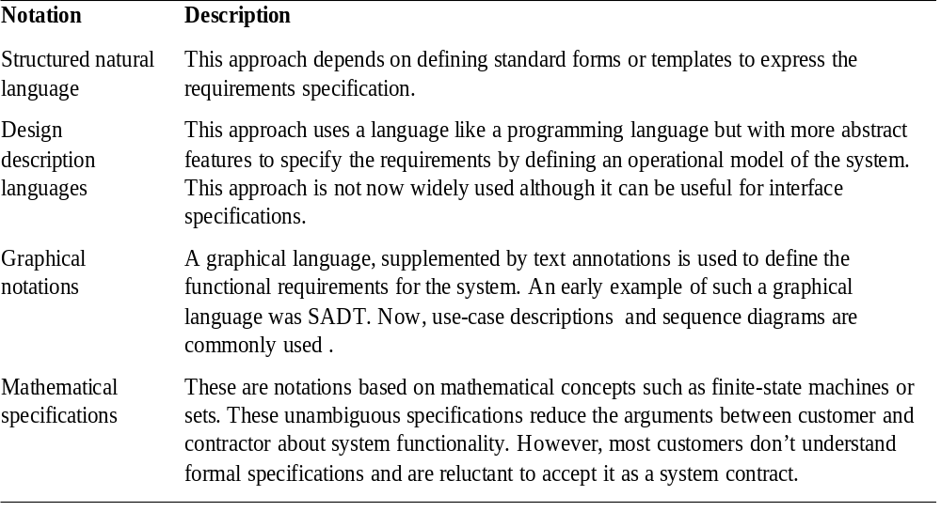
Alternatives to NL specification

Slide 45
Structured language
  The freedom of the requirements writer is limited by a predefined template for requirements.
  All requirements are written in a standard way.
  The terminology used in the description may be limited.
  The advantage is that the most of the expressiveness of natural language is maintained but a degree of uniformity is imposed on the specification.

Slide 46
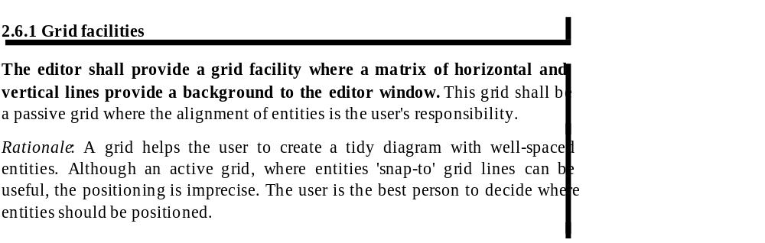
Structured presentation

Slide 47
Form-based specifications
  Definition of the function or entity.
  Description of inputs and where they come from.
  Description of outputs and where they go to.
  Indication of other entities required.
  Pre and post conditions (if appropriate).
  The side effects (if any) of the function.

Slide 48
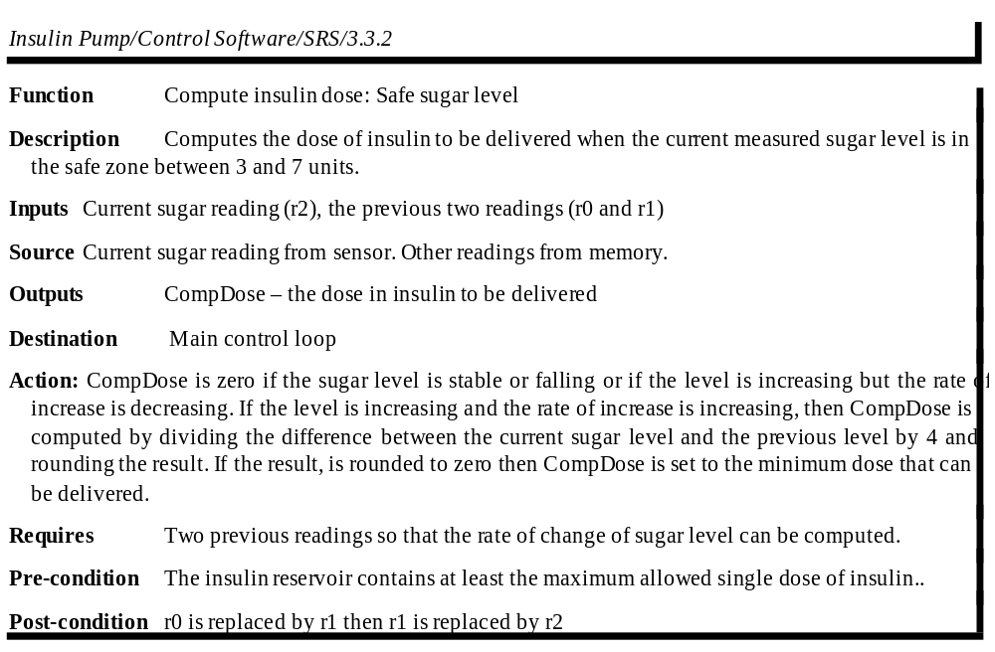
Form-based

Slide 49
Tabular specification
Used to supplement natural language.
Particularly useful when you have to define a number of possible alternative courses of action.

Slide 50
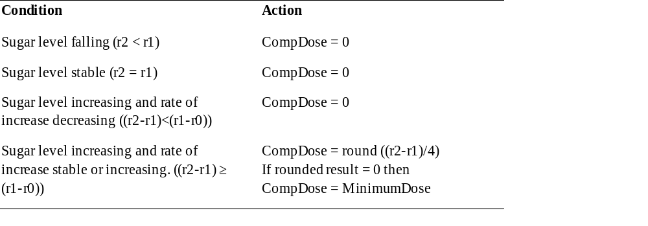
Tabular specification

Slide 51
Graphical models
Graphical models are most useful when you need to show how state changes or where you need to describe a sequence of actions.
See UML, use case diagrams, sequence diagrams, class diagrams.

Slide 52
Sequence diagrams
These show the sequence of events that take place during some user interaction with a system.
You read them from top to bottom to see the order of the actions that take place.
Cash withdrawal from an ATM
  Validate card;
  Handle request;
  Complete transaction.

Slide 53
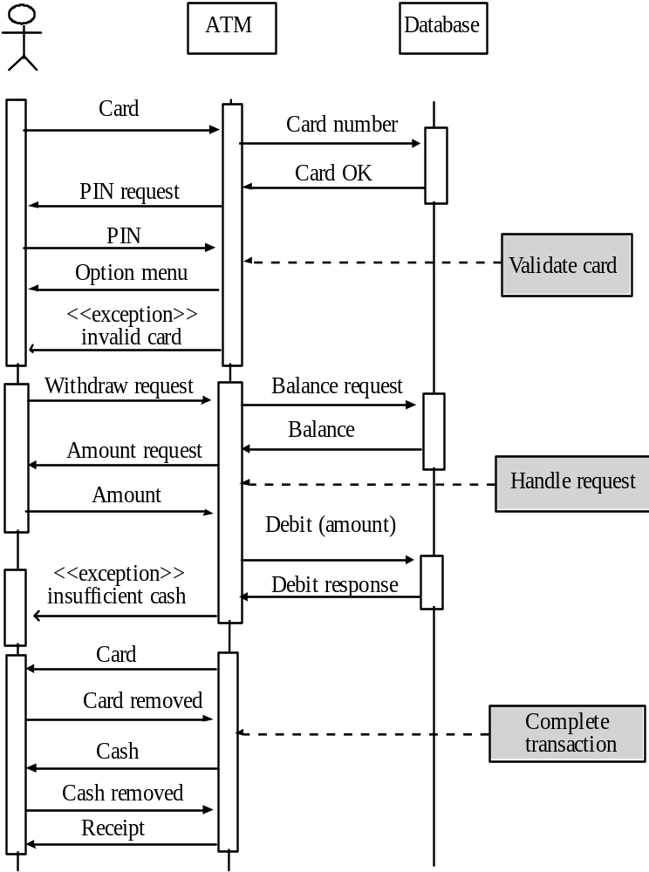
Sequence diagram of ATM withdrawal

Slide 54
Context diagram and interfaces
A key information of the requirement document is the boundary of the system to be developed
  What is inside the boundary (to be developed)
  What is outside (and how the system interacts with it)
    Other systems/subsystems/applications
    Human users

Slide 55
Context diagram and interfaces
Ex. The POS System
Inventory system
cashier
administrator
POS System
Catalogue system
good sold
Credit card system
Bar code reader
Printer

Slide 56
Interface specification
  Three types of interface may have to be defined
    User interfaces, GUIs
    Procedural interfaces;
    Data exchanged;
  Formal notations are an effective technique for interface specification.

Slide 57
 | Physical | Procedural | Data
Credit card system | Internet connection | URL with web service (SOAP – http + xml), and SSL | Format of credit card data sent, error descriptions

Slide 58
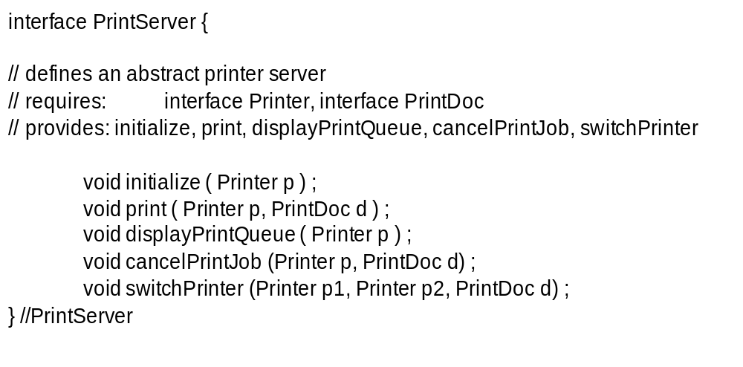
PDL interface description

Slide 59
Data interface
XML

Slide 60
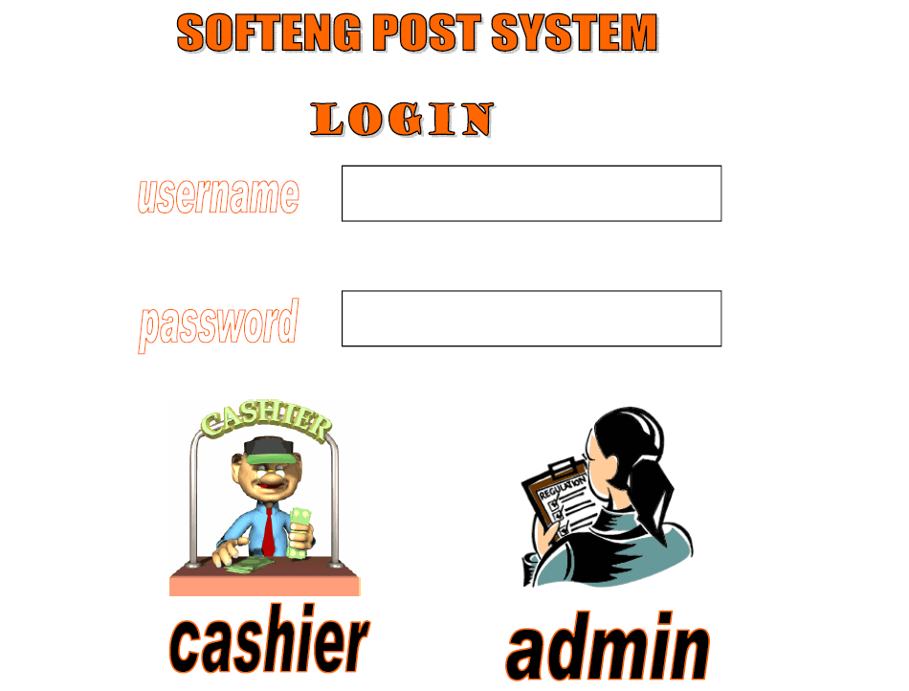
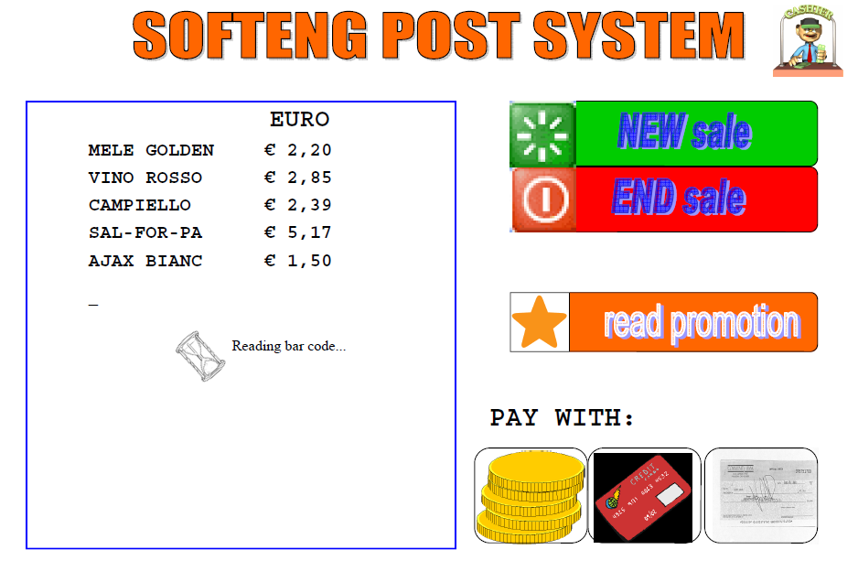
GUI interface
Sketch of interface, typically built with GUI builder

Slide 61
System/developer requirements
More detailed specifications of system functions, services and constraints than user requirements.
They are intended to be a basis for designing the system.
They may be incorporated into the system contract.
System requirements may be defined or illustrated using system models (UML)

Slide 62
Requirements and design
  In principle, requirements should state what the system should do and the design should describe how it does this.
  In practice, requirements and design are inseparable
    A system architecture may be designed to structure the requirements;
    The system may inter-operate with other systems that generate design requirements;
    The use of a specific design may be a domain requirement.

Slide 63
The requirements document
  The requirements document is the official statement of what is required of the system developers.
  Should include both a definition of user requirements and a specification of the system/developer requirements.
  It is NOT a design document. As far as possible, it should set of WHAT the system should do rather than HOW it should do it

Slide 64
IEEE requirements standard
IEEE Std 830 1984
Defines a generic structure for a requirements document that must be instantiated for each specific system.
  Introduction.
  General description.
  Specific requirements.
  Appendices.
  Index.

Slide 65
Req document structure
Preface
Introduction
Glossary
Context diagram and interfaces
User requirements definition
  Functional
  Non functional
System architecture
System requirements specification

Slide 66
Other requirement templates
http://readyset.tigris.org

Slide 67
V&V of requirements
Natural language, UML
  Inspection, reading
    By user, by developer
UML
  Some syntactic check by tools
Formal language
  Model checking
  (see V&V chapter)

Slide 68
Tools
RequisitePro, Doors, Serena RM
Word, Excel
UML tools
  Powerpoint, Visio, specialized tools (StarUML)

Slide 69
Key points
Requirements engineering is a key phase
  Most defects come from this phase, and they are the most disruptive and most costly to fix

Slide 70
Key points
Analysis and formalization
  Free text: unsuitable
  Text with forms, tables, templates (see heating system)
    Context diagrams
    Scenarios
    Requirement id
  UML diagrams
  (formal specifications)
  User vs. developer requirements
  Functional vs. non functional requirements

Slide 71
Key points
Verification and validation
  Inspections (see V and V chapter)
  Build prototype and show to user
  Formal specifications, proofs

